Slide 1
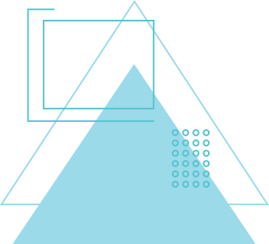
MED-TECH
AI NURSE – VOICE-BASED MEDICAL CHATBOT FOR ELDERLY
Your 24x7 Voice Nurse — Detects, Reminds, and Connects You to Care.

Slide 2

Elderly people often forget to take their medicines or visit doctors on time.
Many of them find mobile apps and technology difficult to use.
Because of this, caregivers cannot always monitor their health properly.
When early warning signs are missed, health problems become serious and lead to emergencies.
So, there is a need for an easy, voice-based assistant that helps the elderly manage their health, reminds them about medicines, and connects them to doctors automatically.

Slide 3
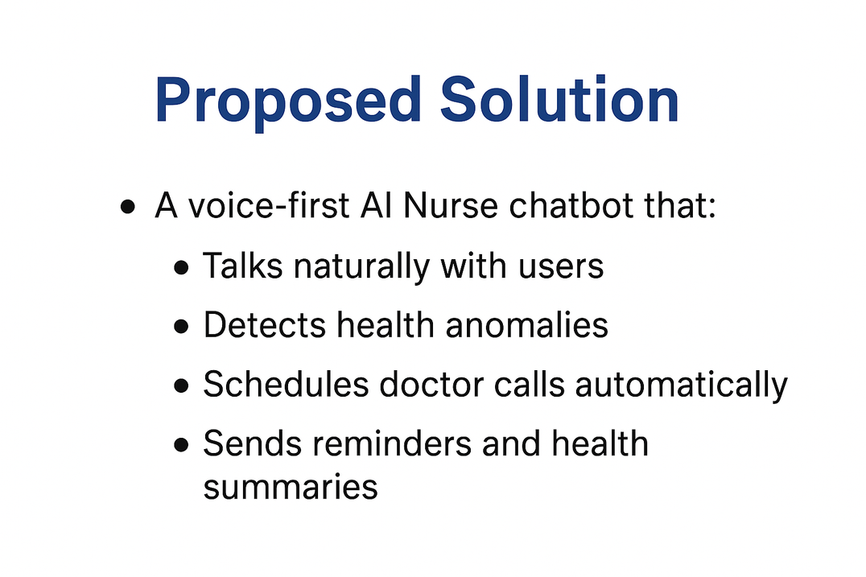
PROPOSED SOLUTION
The AI Nurse is a voice-based medical chatbot designed especially for elderly people.
It can talk naturally with users using simple voice commands, just like speaking to a real nurse.
The system can detect health anomalies by checking symptoms or connected device data.
When it finds something unusual, it can automatically schedule a doctor call or appointment.
It also helps by reminding users about their medicines and sending daily health summaries to caregivers or doctors.

Slide 4
HOW IT WORKS
Voice Interaction:
The user simply talks to the AI Nurse using their voice. The system listens, understands the problem, and asks follow-up questions — just like talking to a real nurse.
Anomaly Detection:
The AI Nurse checks the user’s symptoms or connected health data (like heart rate, blood pressure, oxygen level) to detect any health risk or abnormal condition.
Smart Scheduling:
If a problem is found, the AI Nurse automatically schedules a doctor call or appointment and sends a message to the caregiver.
Medication & Reporting:
The system reminds the user to take medicines on time and sends daily or weekly health reports to doctors and caregivers.

Slide 5
SYSTEM ARCHITECTURE
Frontend:
1. Frontend:
The frontend is the user side of the system — it includes the voice interface where elderly users talk to the AI Nurse.
It uses Text-to-Speech (TTS) and Speech-to-Text (STT) APIs so the system can listen and talk naturally.
2. Backend:
The backend is the brain of the system.
It includes:
An LLM-based chatbot that understands voice commands and user intent.
An anomaly detection model that identifies health risks from symptoms or sensor data.
A scheduler that automatically books doctor appointments.
An encrypted database that securely stores user health records and reports.
3. Integrations:
AI Nurse connects with telehealth platforms and wearable health devices (like smart watches or BP monitors) to collect health data automatically.
4. Hosting:
The system is hosted on secure cloud platforms like AWS or Vercel, ensuring it runs 24/7 and keeps all data safe.

Slide 6
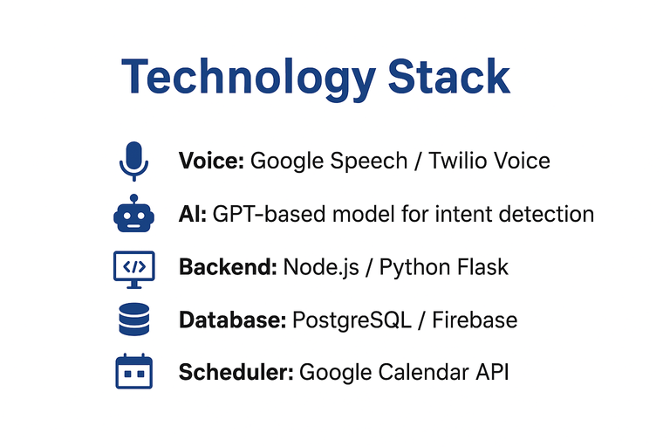
TECHNOLOGY STACK
1. Voice:
Uses Google Speech API or Twilio Voice to convert speech into text and talk naturally with the user.
2. Artificial Intelligence (AI):
A GPT-based model is used to understand user intent, detect health issues, and respond intelligently like a real nurse.
3. Backend:
Built using Node.js or Python Flask, which handle chatbot logic, health analysis, and communication between users and doctors.
4. Database:
Stores user details, health data, and reminders securely using PostgreSQL or Firebase.
5. Scheduler:
Uses the Google Calendar API to automatically book and manage doctor appointments.

Slide 7
CONCLUSION
The AI Nurse is a smart, voice-based health assistant designed to make healthcare easy and accessible for the elderly.
It helps users by detecting health problems early, reminding them about medicines, and automatically connecting them to doctors when needed.
By combining AI, voice technology, and automation, AI Nurse reduces medical risks, improves medication habits, and provides peace of mind to both patients and caregivers.
In short, AI Nurse makes everyday healthcare simple, safe, and human — through the power of voice.

Slide 8
MED-TECH
THANK YOU :

